Slide 1
YOLO face mask detector Zipei Chen

Slide 2
Purpose for this project:
Due to the severity of Covid-19, it is our responsibilities to put our mask on before entering indoor places.

Slide 3
What I have done in this project
1. implemented Two-stage YOLO V1 face mask detector from scratch.
Two-stage: YOLO v1 face detector + Alex Net face mask classifier
2. trained the YOLO v5 object detector on my own face mask dataset.

Slide 4
The two-stage YOLO V1 face mask detector YOLO V1 + ALEX NET

Slide 5
The inference steps of YOLO V1
Input an image
Divide the image into multiple grids
Each gird will generate a bounding box and the class information (represented in the one-hot encoding form). A bounding box contains 5 values: [center x, center y, width, height, confidence score]
Using non-maximum suppression (NMS) to get the target bounding boxes. （set a threshold to remove unrelated boxes.）

Slide 6
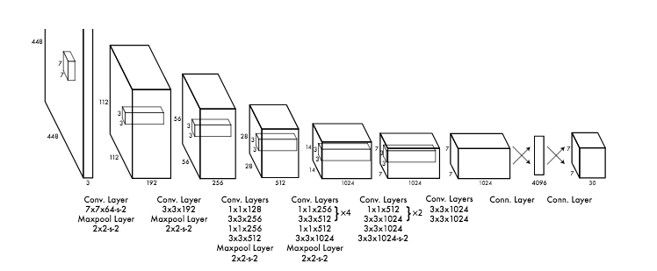
The structure of YOLO V1
YOLO v1 applied a Convolutional Neural Network to output the bounding boxes information.
24 convolutional layers for extracting features + 2 linear layers for classification and bounding boxes regression.
Loss Function: center loss + width and height loss + object loss + no object loss + classification loss.

Slide 7
The Alex Net classifier
Trained on 4000 images with data augmentations(flip, crop)
Validation accuracy reached 100%

Slide 8
The two-stage YOLO v1 Facemask Detector
output
Input
Input
YOLO V1 Face Detector
Bounding boxes
Target bounding boxes
Face image
(224*224*3)
Image
(448*448*3)
NMS
Crop&
Resize
Drawing bounding box
output
Label info
(face mask vs no face mask)
Alex Net
Classifier
result
Put labels upon the box

Slide 9
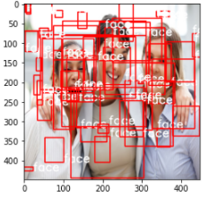
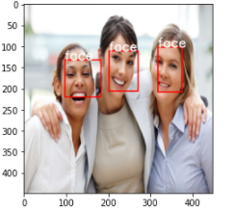
Image prediction:
NMS

Slide 10
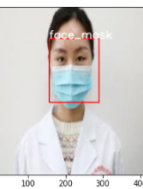
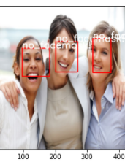
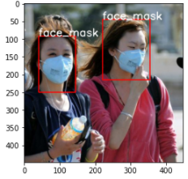
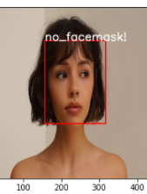
Image prediction

Slide 11
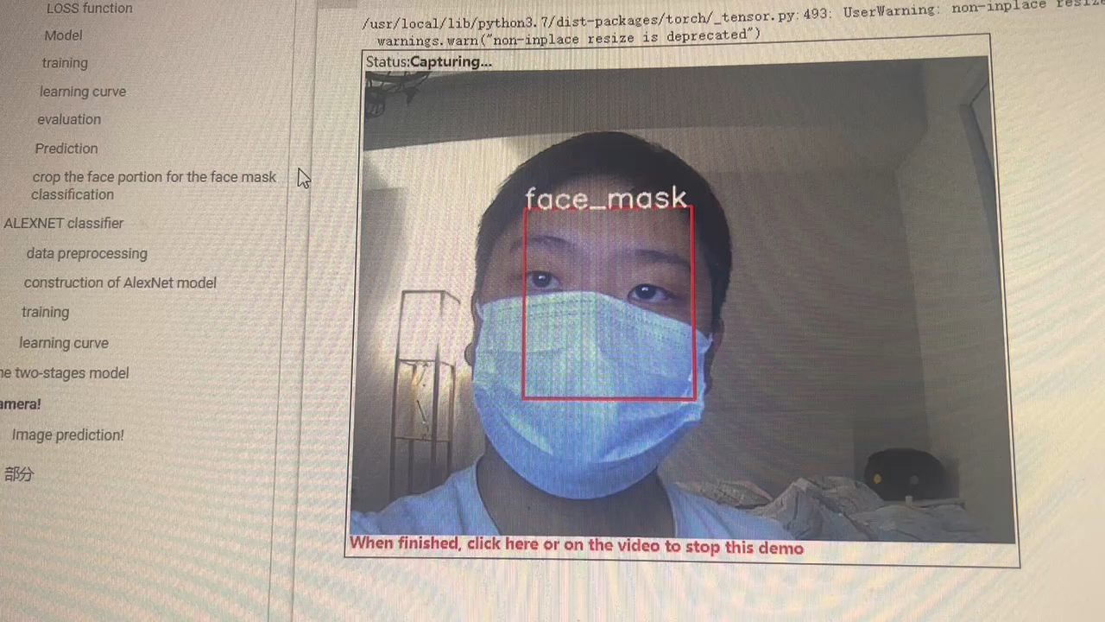
Video prediction:

Slide 12
Difficulties I met during this project
1. YOLO v1 performs bad on small objects
Solution: use yolo v1 to detect face which is a larger object compared with face mask and use another classifier to do the classification.
2. the confidence score of unrelated bounding box is larger than the confidence score of target bounding box.
Solution: modified the object loss and no object loss in the loss funciton.
for true bounding box: confidence score -> 100 instead of 1
for unrelated bounding box: confidnece score -> 0
the range of confidence is modified from 0- 1 to 0 - 100

Slide 13
The YOLO v5 face mask detector

Slide 14
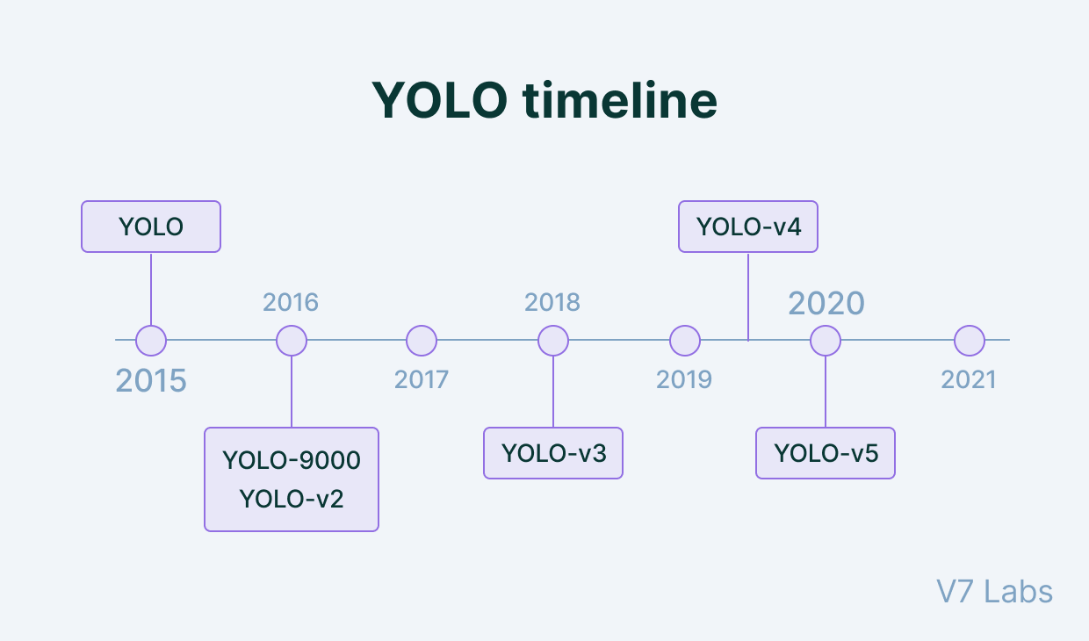
The evolution of YOLO

Slide 15
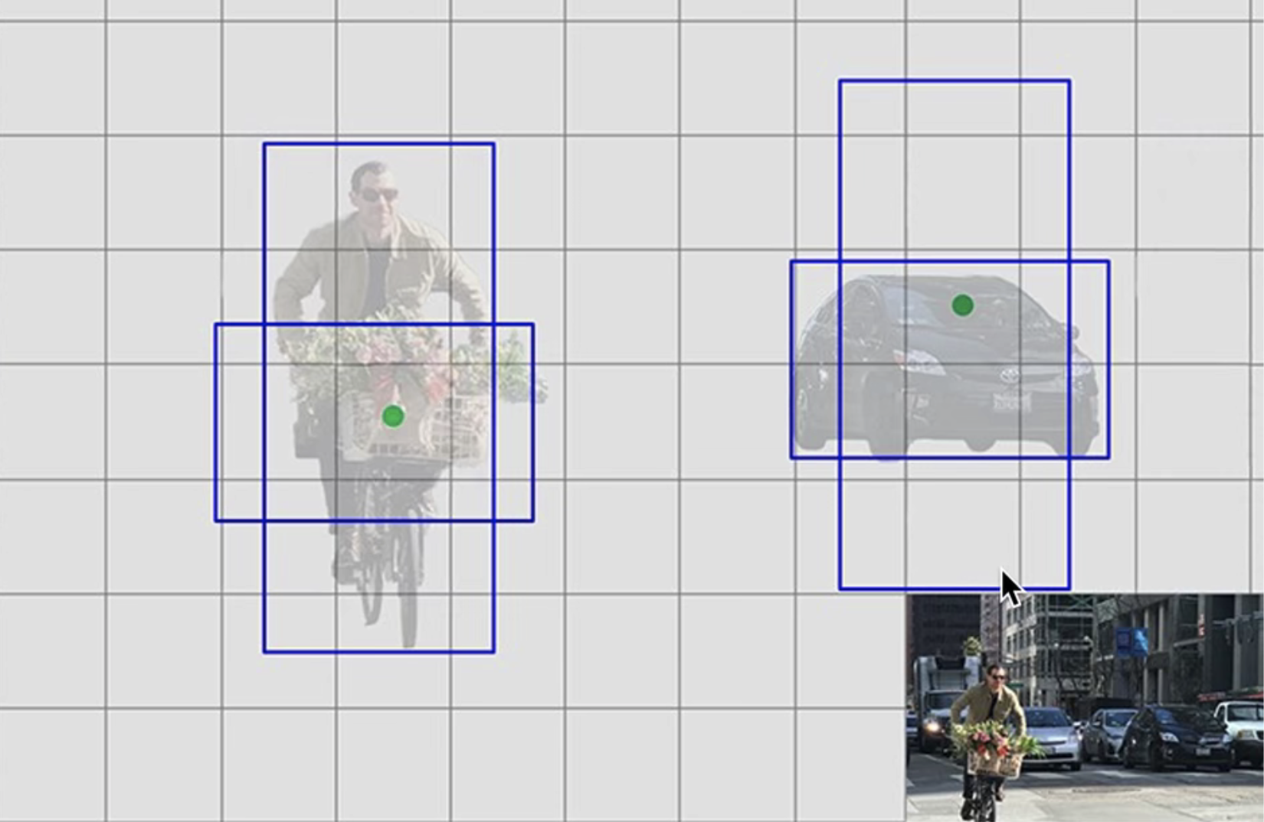
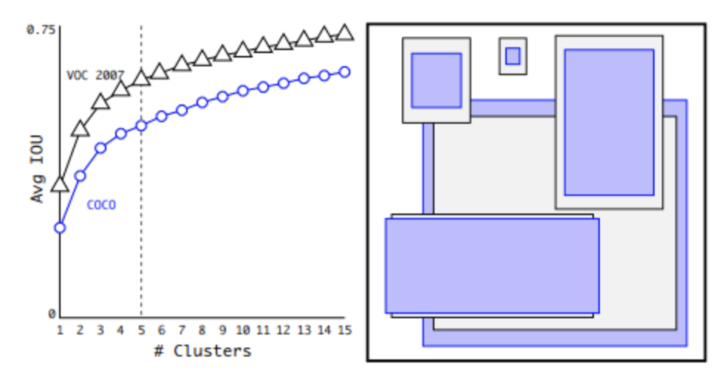
YOLO V2:
It introduced prior anchor boxes instead of the automatically generated bounding box to make prediction.
The number and size of anchor boxes are pre-determined by using the result of k-means algorithm.

Slide 16
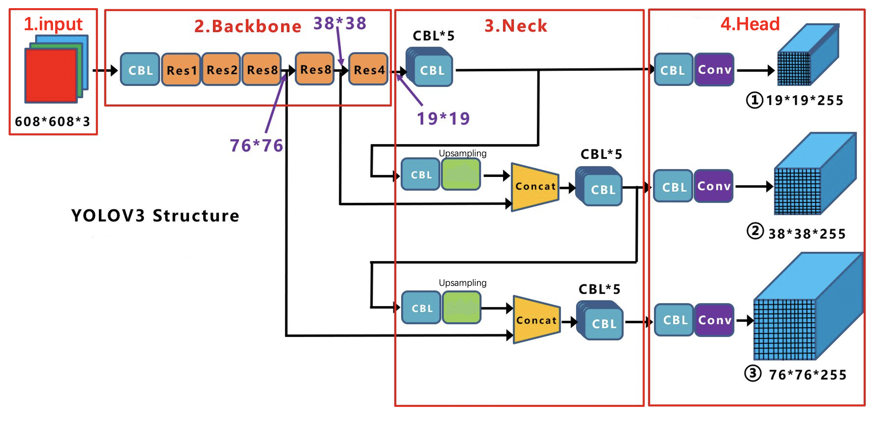
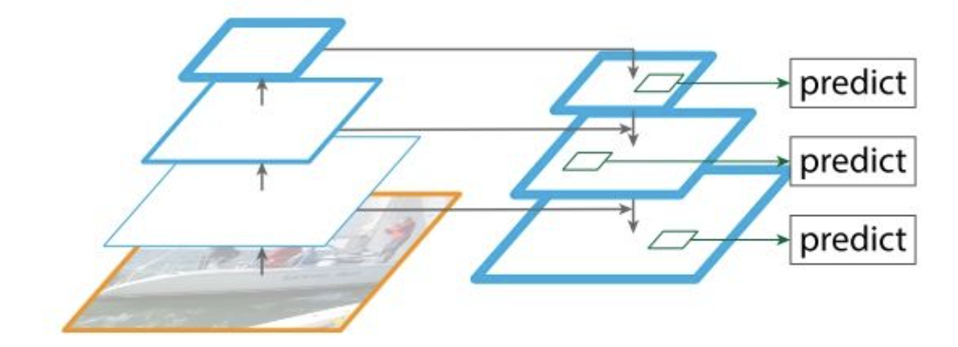
Yolo v3
BackBone: extract features
Neck: applying FPN(featurized image pyramid) to collect feature maps from different stages.
Head: do prediction. Here we could get three featrue maps and each responsible for detecting different size of images. (performs good on both big and small objects)

Slide 17
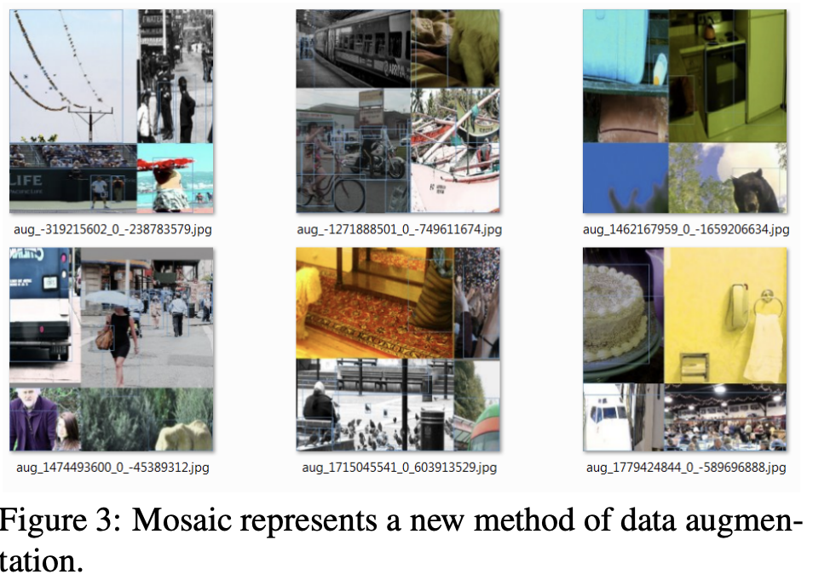
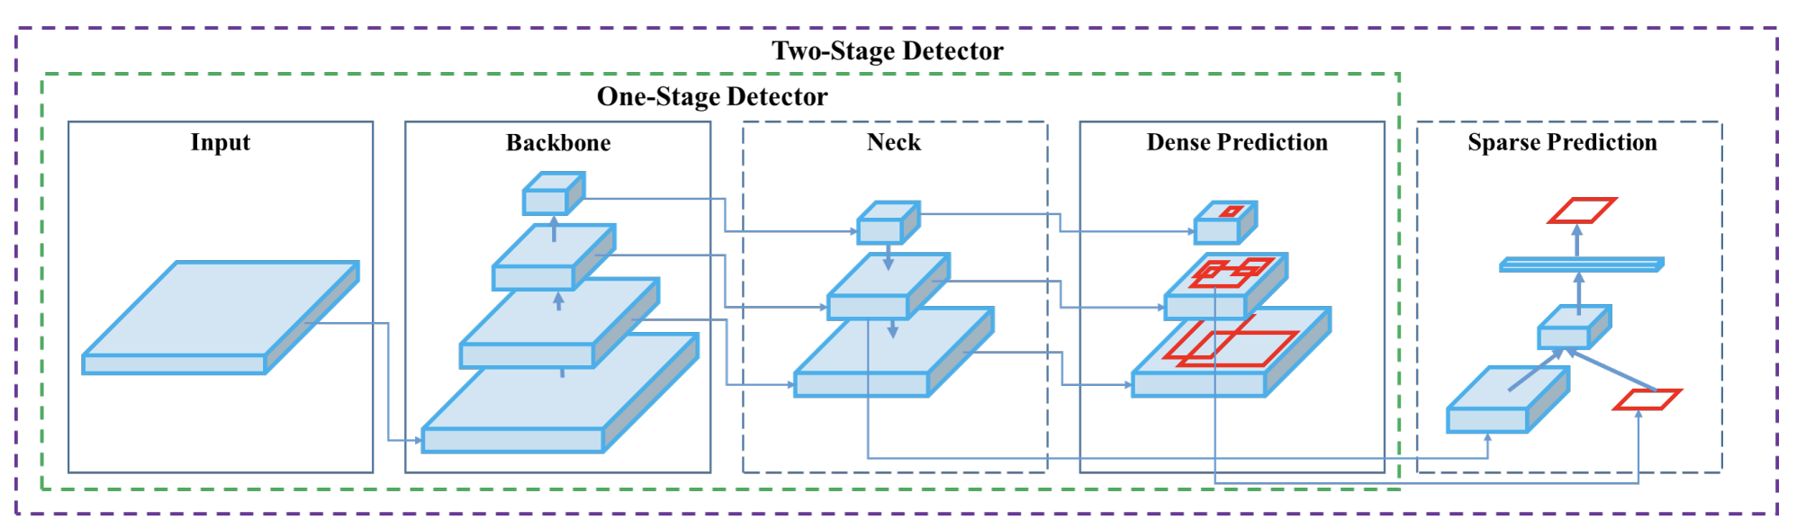
YOLO V4
1. Introduced mosaic data augmentation
Make the model learn to recognize objects in a smaller range.
significantly reduce the demand for batch-size thus decrease the demand for GPU resources.
2. Improved the backbone, neck and head model and increased the
performance of the model significantly.

Slide 18
YOLO V5
Very similar to YOLO V4
Use the Pytorch framework instead of the Darknet which is very user-friendly and can easily be trained on our own data sets.
Require significant less time for training than YOLO v4
Process 140 images in one second. (140 FPS)

Slide 19
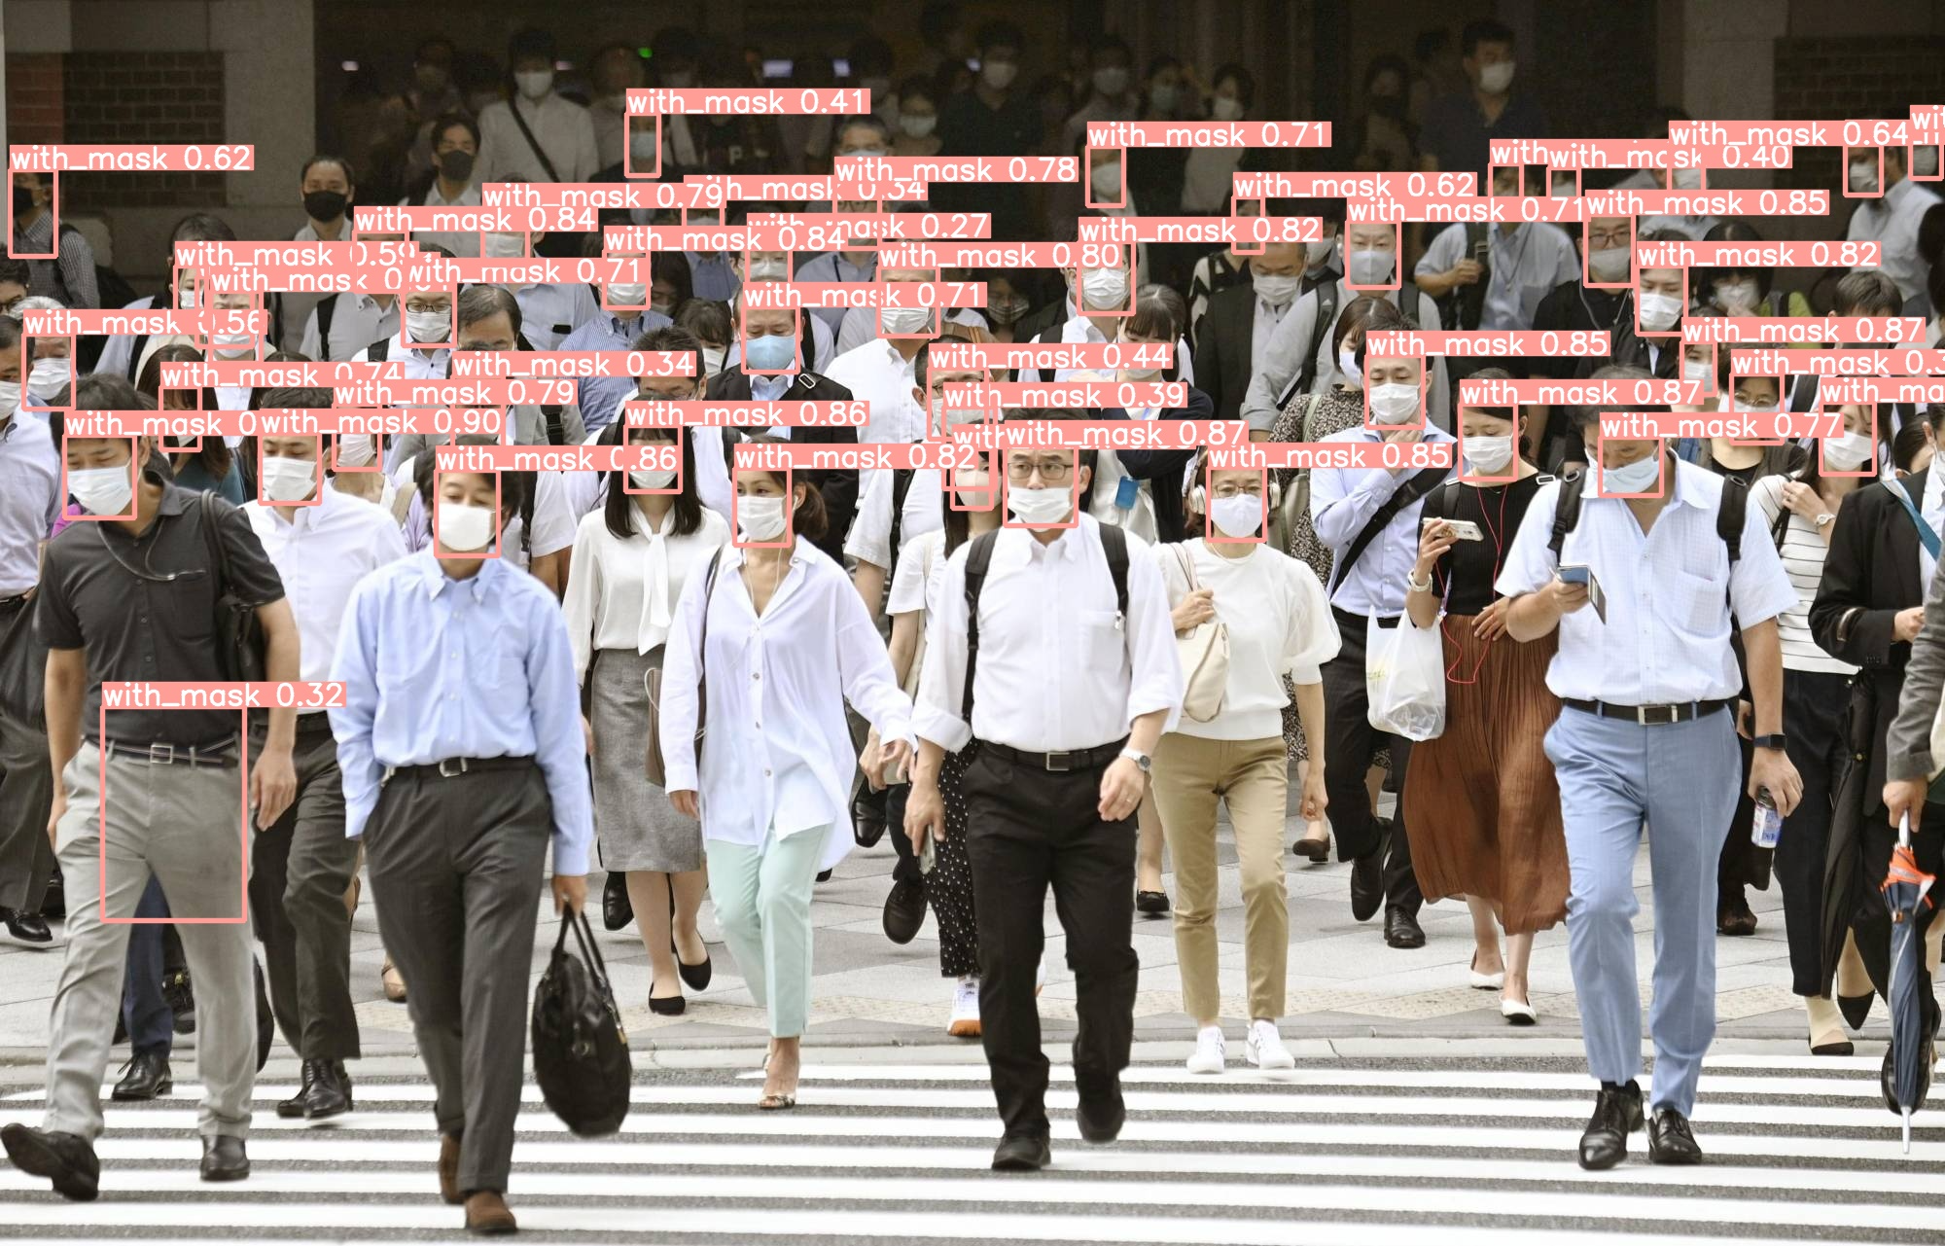
Prediction result
Performs very good on detecting small and crowed objects by only training this model on 600 images!

Slide 20
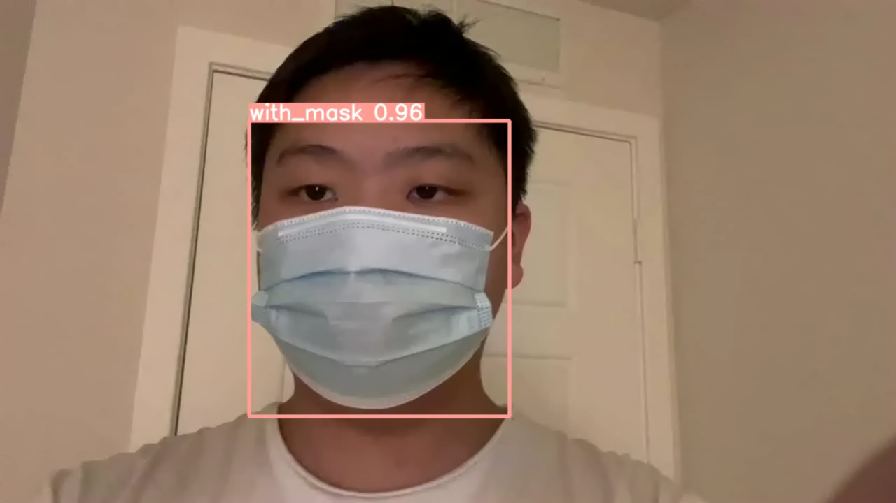
Video prediction (Two-stage YOLO v1 vs YOLO v5):

Slide 21
Training time
 | Two Stage YOLO V1(600 images 60 epochs) | Yolo v5 (600 images 60 epochs)
Time | 1 hour | 30 minutes
Device | GPU | GPU

Slide 22
Conclusion
YOLO V5 performs much better than two-stage YOLO V1 in every espects: training time, training image required, inference time, accuracy, ability to handle small objects.
Several ideas that I think may increase the performance of the two stage YOLO V1 without changing the main structure.
1. do data augmentations just like YOLO v4 to the input image.
2. remove the linear layers in YOLO V1 resiponsible for the classification task to increase the inference speed since there is only one class
3. trained it for more epochs because the model is still converging when I trained it for 60 epochs.
4. Add a Neck to get feature maps of different scales to make the model perform better on small objects.

Slide 23

Thank you!

